Slide 1

WEEK 03 DELIVERABLE
DATA VISUALIZATION ASSOCIATE EARLY INTERNSHIP
Prepared By: Team 37
22-September-2025

Slide 2

OUTLINE
Part 1 : SQL Scripts for Validation
Part 2: Data Validation Report
Part 3: Visual Representations
Part 4 : Insight Summary
Part 5: Recommendation and Conclusion

Slide 3
SQL Scripts for Validation...
A Set of SQL Queries used for data checks, including validation of record counts, duplicates, missing values, consistency check and business rule alignment

Slide 4
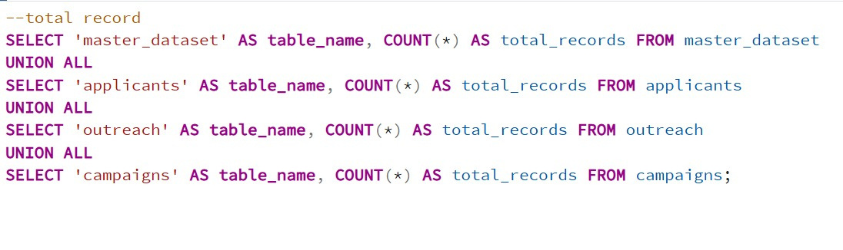
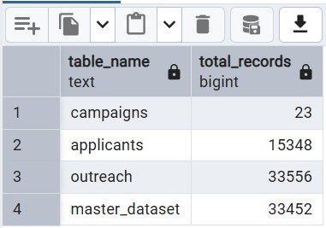
Validation of Record Counts
Code
Result

Slide 5
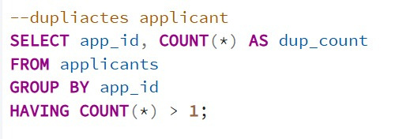
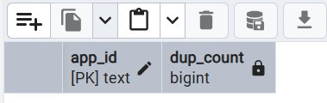
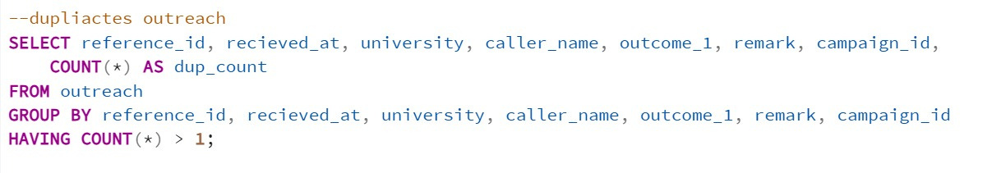
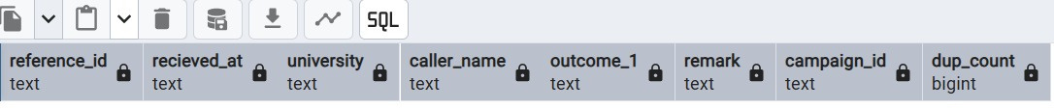
Validation of Duplicates
Code
Result
Applicant data:
OutReach data:

Slide 6
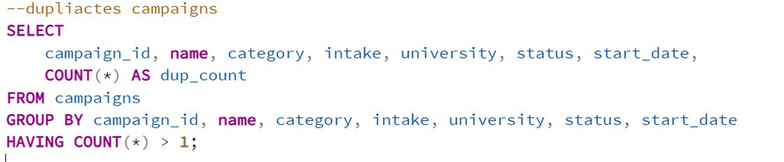
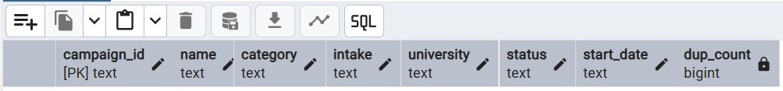
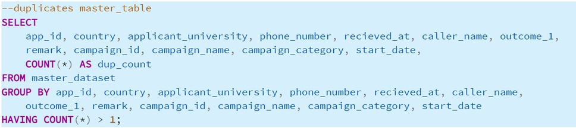
Validation of Duplicates
Code
Result
Campaign data:
MasterTable data:

Slide 7
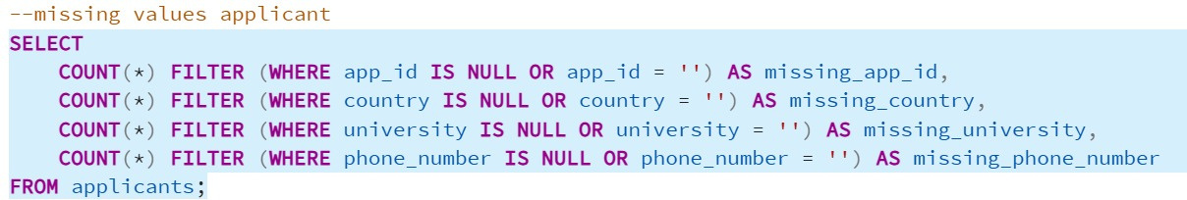
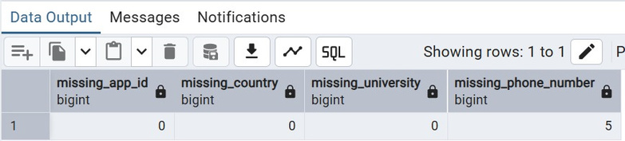
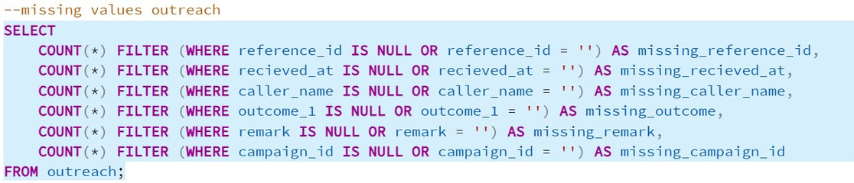
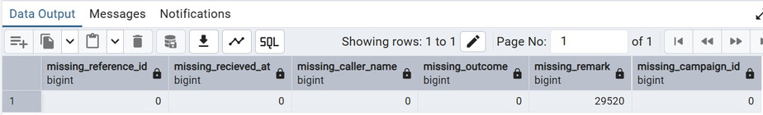
Validation of Missing Values
Code
Result
Applicant data:
OutReach data:

Slide 8
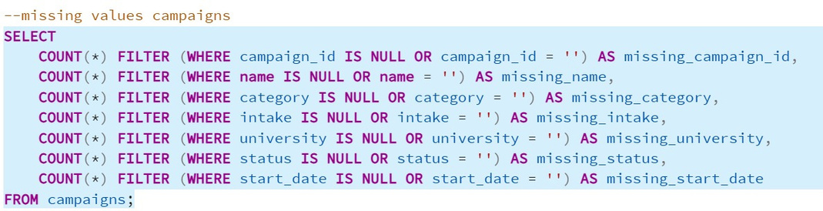
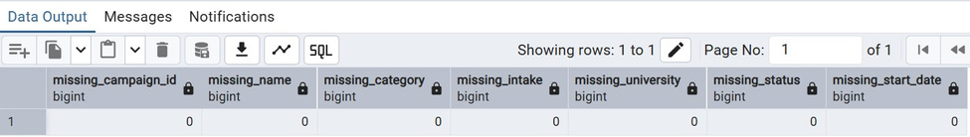
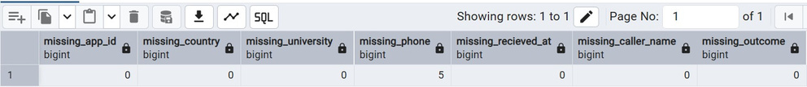
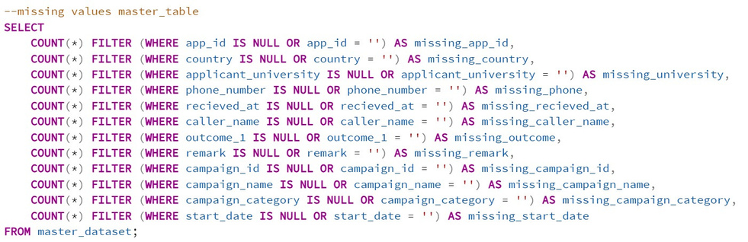
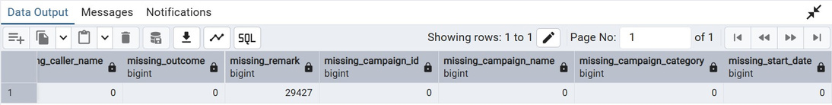
Validation of Missing Values
Code
Result
Campaign data:
Master Table data:

Slide 9
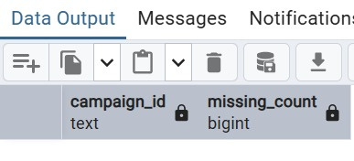
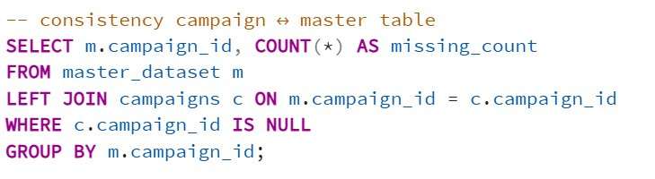
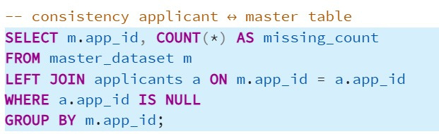
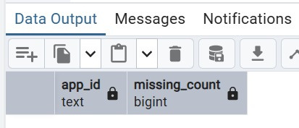
Validation of Consistency
Code
Result
Campaign data:
Applicant data:

Slide 10
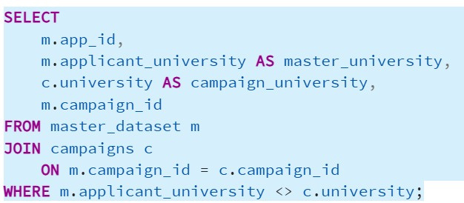
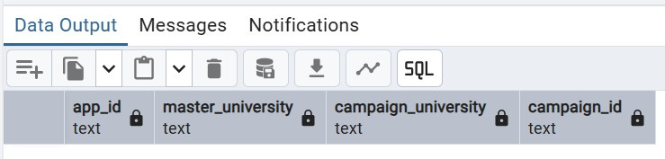
Validation of Consistency
Code
Result
University data:

Slide 11
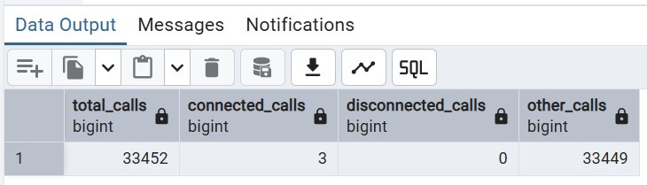
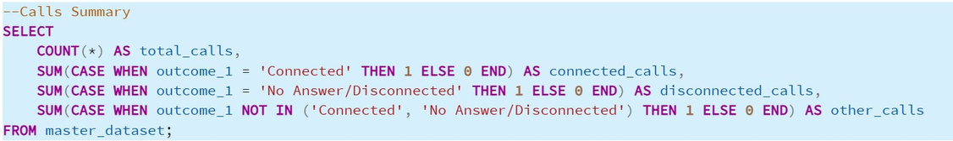
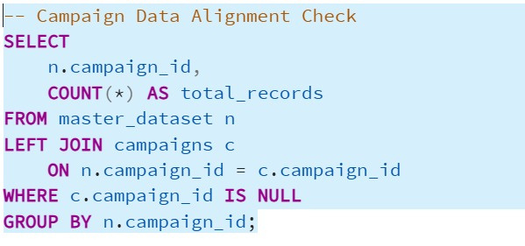
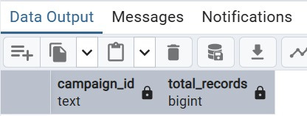
Validation of Business Rule Alignment
Code
Result
Call Outcome Summary
Campaign Alignment Validation

Slide 12
Data Validation Report
A Summary of identifies issues and Steps taken to ensure data accuracy and completeness

Slide 13
Identified Issue | Action Taken
Duplicate Records across Applicant, Outreach, Campaign, and Master tables | Deduplication performed using unique keys, merged overlapping entries, and applied constraints to prevent recurrence.
Missing Values in key fields (emails, phone numbers, campaign/master data) | Backfilled from source logs where possible, imputed defaults, flagged critical nulls for manual enrichment.
Record Count Mismatches between source datasets (Applicant vs. Master Table, etc.) | Reconciled using outer joins, corrected ETL loads, and automated record count checks.

Slide 14
Identified Issue
Action Taken
Data Inconsistency (naming differences in universities, campaigns, applicants) | Standardized formats using mapping tables, normalization, and enforced consistency rules.
Business Rule Violations (e.g., invalid call outcomes, misaligned campaign mappings) | Corrected mappings, aligned with business rules, and enforced referential integrity.
Format Issues (date inconsistencies, non-standard entries) | Standardized to ISO format (YYYY-MM-DD), validated ranges, and applied uniform formatting.

Slide 15
Visual Representations through Looker Studio

Slide 16


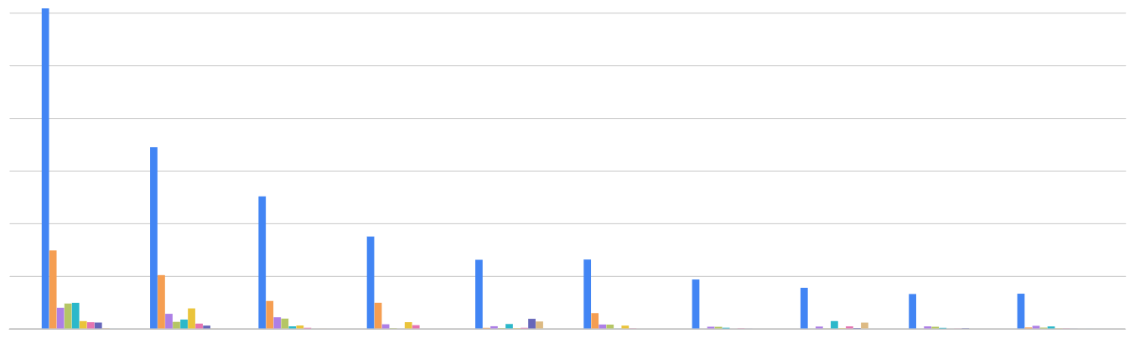
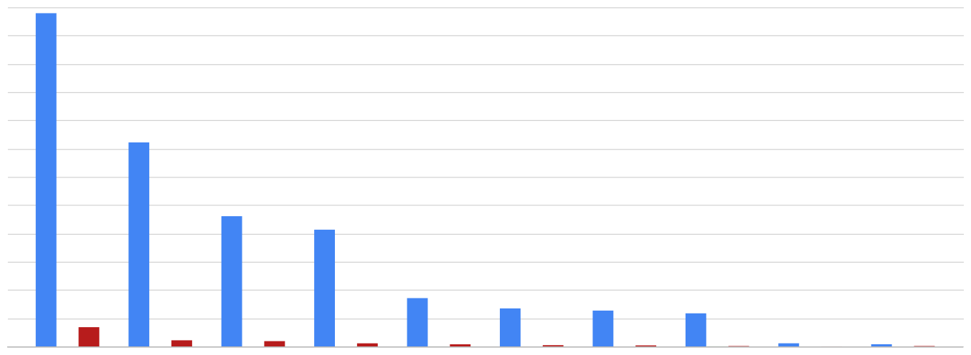

Record Count
33,452
Total Connected Calls
3
Disconnected Calls
1,380
Connectivity Rate
0
Calls by Campaign with Outcome
KPI
Not connected
Will Submit the docx
Disconnected
Wrong number
country
▼
Select date range

Agent Performance
12K
Record Count
Total Connected Calls
Disconnected Calls
10K
8K
6K
4K
r Gs Sp2…
r Gs Call…
r Gs Sp2…
r Gs Call…
eposit, N…
r Gs Call…
r Gs Sp2…
r Gs Call…
2K
Calls Distribution by Country
0
Rudra
Prajwal
Jyoti
Palak
Isha
Poppy
Shrutish
Shailja
Namrata
Twinkle
Visualization
Calls Distribution by Campaign Category
12%
32.6%
India Unknown Ghana Nigeria Pakistan
21.2%
3.7%
3.8%
Iran Bangladesh Nepal South Africa Others
Post Admission Pre Admission
10.1%
0
11.6%
20.1%
r Gs Sp2…
r Gs Sp2…
78.8%

Slide 17
Insight Summary
This report provides a comprehensive overview of our recent campaign performance, highlighting key metrics,trends,and actionable insights

Slide 18
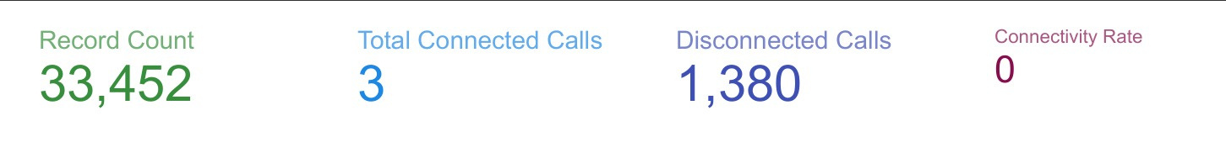
Record Counts: Total Number of record reached
Total connected Calls: Successful Number of Connection made
Disconnected Calls: Calls that resulted in disconnection
Connectivity Rate:
Handled calls that resulted in connection

Slide 19
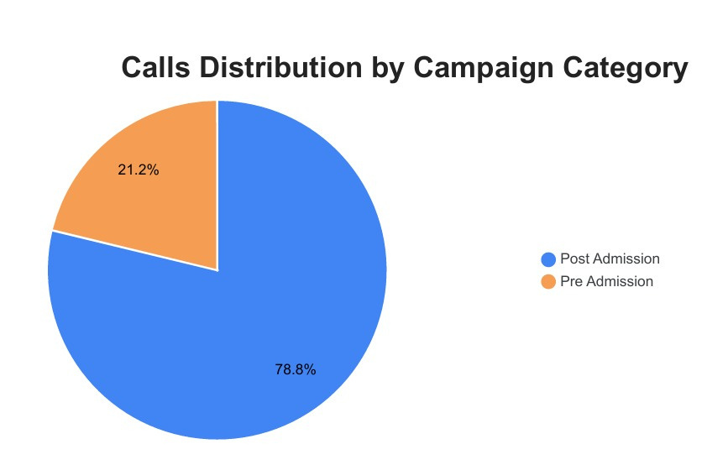
Call Rate
High rate of unsuccessful calls ⟶ A low overall success rate

Slide 20
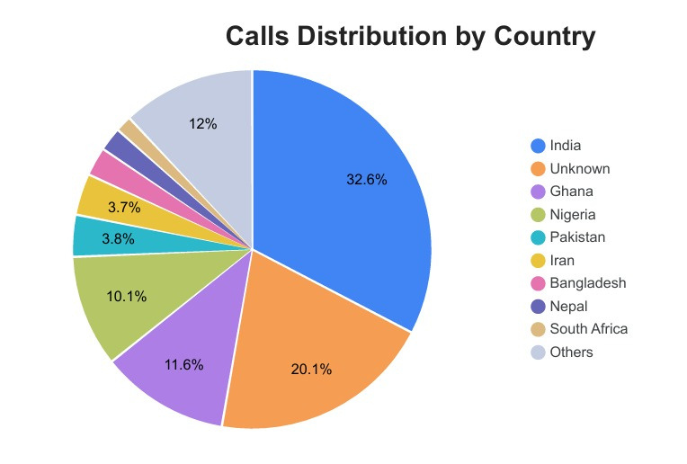
Connected Call Distribution
Highest rate : India

Slide 21
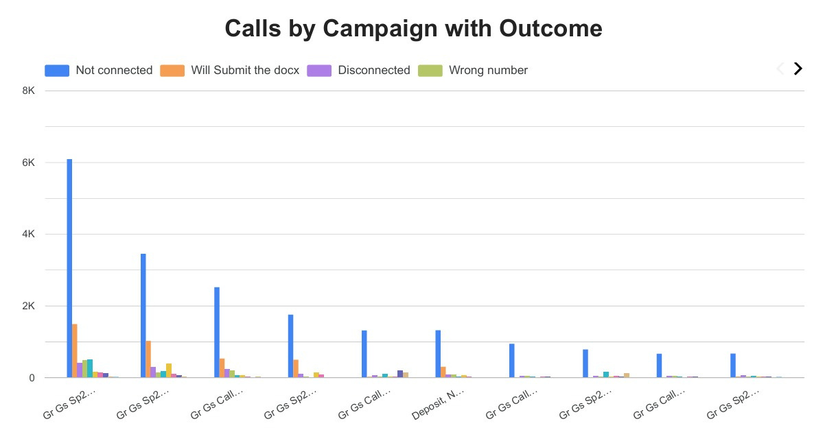
Campaign Outcome Comparison
Some Campaign achieved higher connectivity
Some almost unanswered

Slide 22
Recommendation and Conclusion

Slide 23
Recommendation:
Automate Checks – Run SQL scripts regularly for duplicates, nulls, and record counts.
Enforce Rules – Apply NOT NULL, UNIQUE, and FOREIGN KEY constraints.
Standardize Data – Use consistent formats for dates, IDs, and names.
Data Governance – Assign stewards to monitor integrity and rules.
Improve Documentation – Keep logs of validations and fixes.
Train Teams – Educate staff on data entry standards to reduce errors.

Slide 24
Conclusion
The data validation process helped identify critical issues such as duplicates, missing values, inconsistencies, and rule violations. Corrective actions like deduplication, data standardization, and rule enforcement improved the reliability and completeness of the datasets. Moving forward, consistent monitoring, automated validation, and stronger governance will ensure higher accuracy, making the data trustworthy for reporting, insights, and decision-making.

Slide 25



